Slide 1











Pharmacy Management System
Supervisor
prof/Dr/Ahmed abo taleb

Slide 2
ABSTRACT
This program is a pharmacy management system can store the
medicine information in databases we divide items into three
main category: medicine , cosmetics and healthy products, we
divide each category into many sub categories such as medicine
divided into seven subcategories and so on , we could use the
program to add items in each category, update existing items , or
search for a specific one or even delete items and finally we could buy as many items as we want that we are creating purchase and generate total amount of purchase, the program is divided into
two main program:

Slide 3
The project Divided into
Online website
we have been made an online website to generate total amount
of purchase. We are using mysql , html , css , javascrip and php
to implement this category.
Offline program.
In this program we are using c++ with mysql to create and
generate total amount of purchase and do any specific task.

Slide 4

Programs we used in our project
1
Xxamp
2
Notepad ++
3
Codeblocks
4
Git
5
Dev c++

Slide 5






Slide 6
why c++ and not python ??
speed
Memory Consumption
Difficulty in Using Other Languages
Simplicity
Compatibility

Slide 7
Starting with the c++ program, how its flow
http://www.free-powerpoint-templates-design.com

Slide 8
Main function
users
menu
Which cat
process
Exit

Slide 9
users
At the first began you have to enter your username and password, you won’t allowed to access data until you enter an existing username and password.

Slide 10
menu graph
addin
showin
menu
buyin
updatein
findin
deletein
controls

Slide 11
categories
Primer
 | Lipstick Face Powder Rouge Highlighter
 | Shampoo Hair cream Face cream Tooth paste
 | Creams Lotion Syrup Tablets Capsule Injection Solution.
healthy
Cosmetics
Medicine type
Concealer

Slide 12
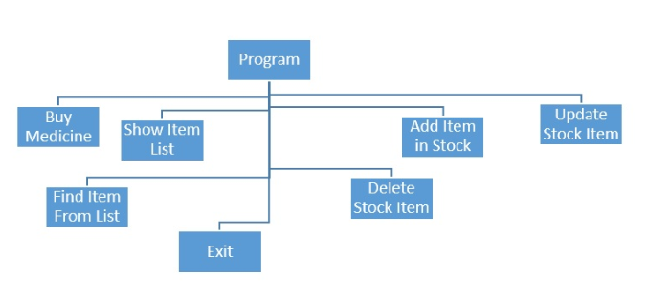
We have seven main function:

Slide 13
Function BuyMedicine();
• This function is for the customer in Pharmacy Management System • If the customer wants to buy medicine the seller can easily make a list of medicine and create a total bill of the medicines. • Here all the medicine in the list will showing in the console • Seller can choose medicines more than ones • Simple “Select” query get all the medicine from the list • Then after validation of ids the total number of medicine will decrease after all purchase • And update the database • As well as show the total amount of purchased medicine

Slide 14
Buy medicine
Which cat
Which item
buy
Edit
Exit

Slide 15
Function ShowItemList();
• Showing all the items in the database in Pharmacy Management System.
“Select” query will get all the data from the database
And display in the console
It is simply shows items in any category

Slide 16
showitemlist
Which cat
Which item
process
Exit

Slide 17
Function AddItemStock();
• User can add new medicine with this function
“Insert” query is used for add item in the database
User can fill all the information of the medicine
Then the information’s are added in the database

Slide 18
Additemstock
Which cat
process
Exit

Slide 19
Function deleteStockItem();
User can delete any item from the database
“Delete” query is used to delete information
User simply type the id of the item and delete the item from the database with a message
It can validate the given number and show proper message in the console

Slide 20
deletestockitem
Which cat
process
Exit

Slide 21
Function UpdateStockItem () ;
If the user wants to update any information of the item in the list then this is the function
“Update” query is used to update the database information.
User can keep the old data in the database by typing simple keyword “xN”
Then the database will update the information
It can validate the given number and show proper message in the console

Slide 22
Updatestockitem
Which cat
process
Exit

Slide 23
Function FindItemFromList ();
User can find item from the list in Pharmacy Management System
Only with few characters of the name
of the item the program can find all
the similar product
And display all the information in
the console

Slide 24
finditemfromlist
Which cat
process
Exit

Slide 25
tracing
It was a good question we have asked ourselves , how admin keep tracking and view what a specific user do , for example there are five person having access to the database , and can buy, delete , update , and add items to stock, if you want to see who did what after one day , one week , on month even a year, we thought about a intelligent mechanism to achieve such tasks.

Slide 26
Lets jump into website
http://www.free-powerpoint-templates-design.com

Slide 27
Control graph
home
Cart
Index page
About Us
LOGIN
REGERSERATION
contact
categories

Slide 28
categories
Primer
 | Lipstick Face Powder Rouge Highlighter
 | Shampoo Hair cream Face cream Tooth paste
 | Creams Lotion Syrup Tablets Capsule Injection Solution.
healthy
Cosmetics
Medicine type
Concealer

Slide 29
Home page
when you start brows our website you would access the home page, you have a lot of choices, in the blank area, there are the most recent medical reports you could read.
Now you have to take your own decision, you could register new account , login with an existing account or even continue browsing without register, you can check our products, you can also read the most recent medical reports, you could read about the pharmacy , give your feedback and finally you can search for a specific item.

Slide 30
Registeration
First you have to register, enter your first name , lastname , Gender , email , password , phone number, address, city , county and your birth of data, that the pharmacy delivery team could deliver your order, click on the top left control button “RGISTERATION” to access registeration page

Slide 31
login
If you have an email that was
Registered before, Just enter your user id and password and keep going..
If you forget password or email
Tell us and we will help you.

Slide 32
search
Assume you want to search about a specific element , just write element name in the input form on the top left of the page

Slide 33
categories
We have three categories with
Many sub-categories, you could
Browse what you want , then you
Have the power of buying anything
You want.

Slide 34
About Us
Give the client information about
The pharmacy, such as , manager,
History , numbers , improvements,
Services , address and etc.

Slide 35
Contact
Give the client opportunity to
Call the pharmacy service team,
Give us his feedback , and advices, we could collect data
About clients impressions.

Slide 36
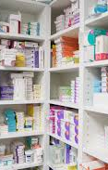
Offline advantages
speed
Time Efficiency
consume human efforts
Reliability
Good security

Slide 37
Online advantages
Better Health for Customers, Better Business Health for Pharmacies

Slide 38
drawbacks
Unlicensed Pharmacies
Risk of Counterfeit Drugs
Risk of Counterfeit Drugs
Privacy not Guaranteed for online part
Late delivery

Slide 39
Future aims
1
Improve performance
2
gui
3
Using oop
4
Buying online server
5
Mobile app

Slide 40
Future aims
6
penetration test
7
Use another design
8
Use another design
9
Avoiding online defects

